Slide 1
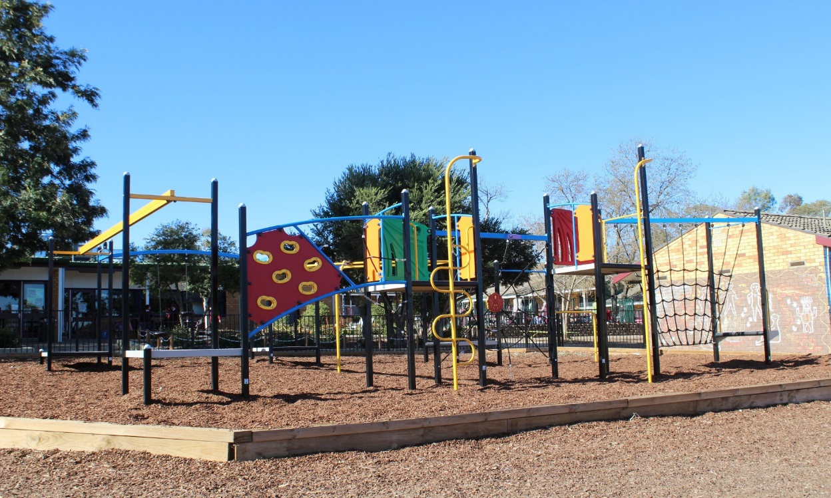
Starting school at Oxley Vale Public School

Slide 2
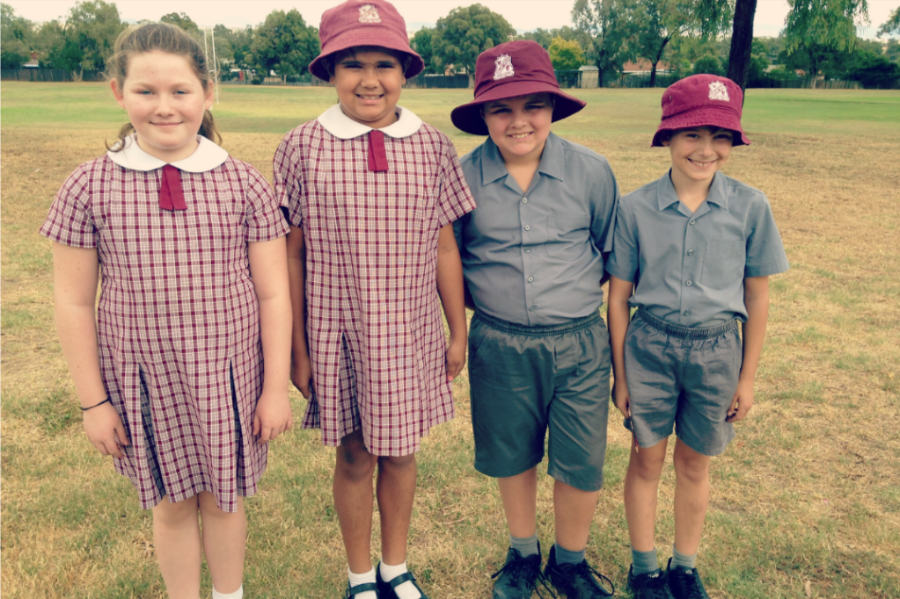
I will wear my school uniform to school. My school uniform looks like this!

Slide 3
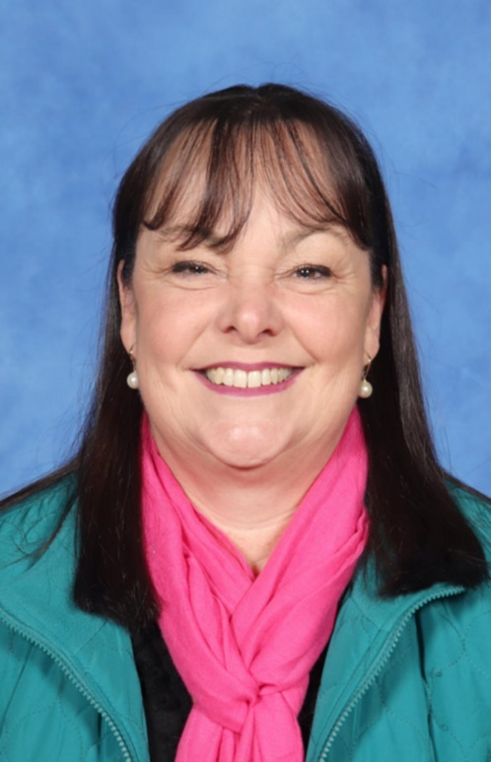
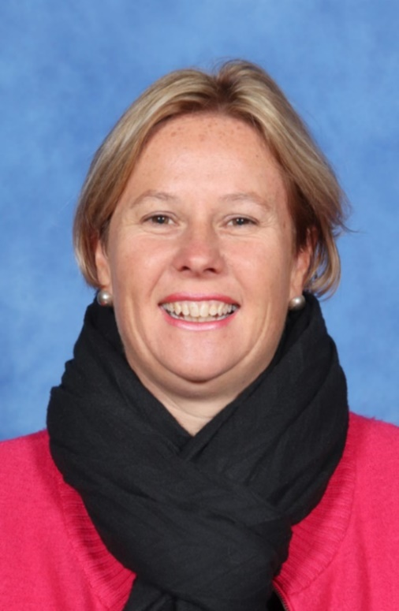
This is Mrs Murray and Mrs Porter. They will take care of me at school.

Slide 4
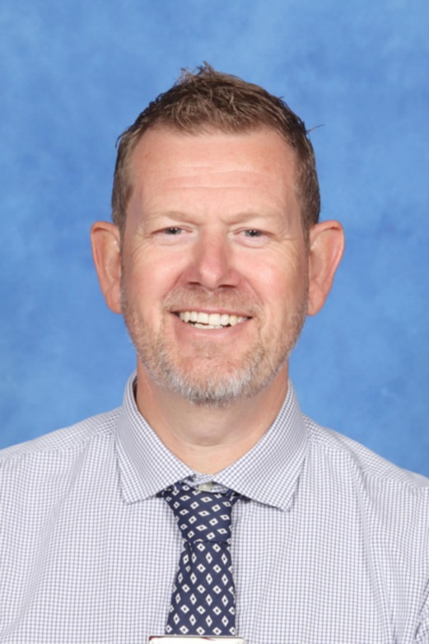
This is the Principal of the school. The Principal’s name is Mr Norman.

Slide 5
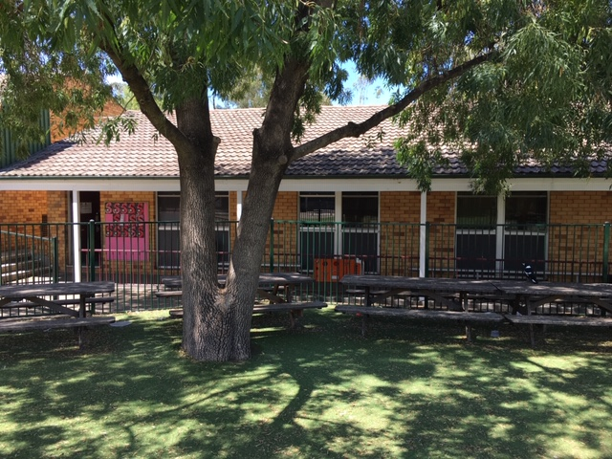
This is where we will line up before we go into our classroom.

Slide 6
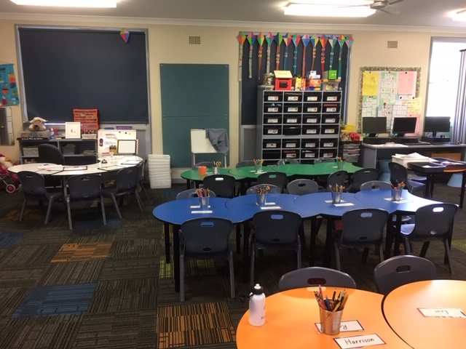
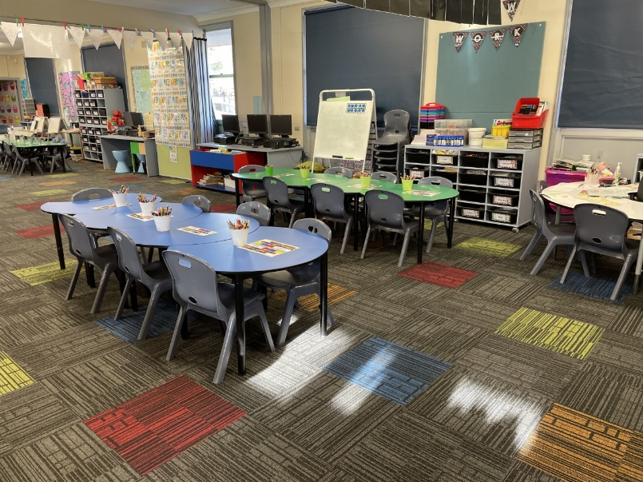
This is my new classroom.

Slide 7
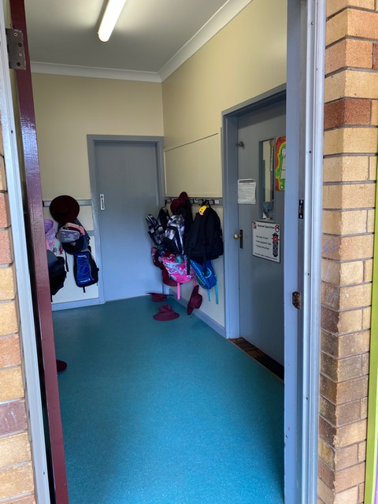
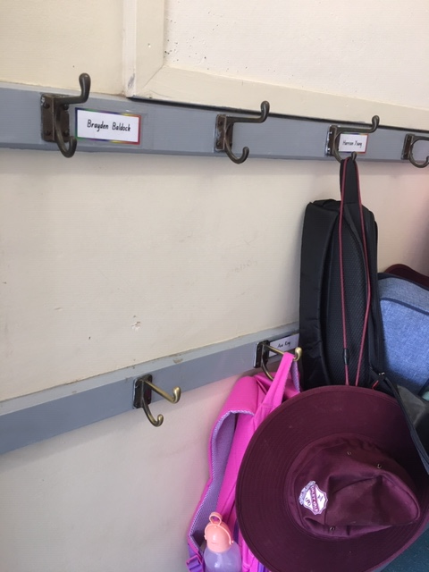
This is where I put my bag when I come to school every morning.

Slide 8
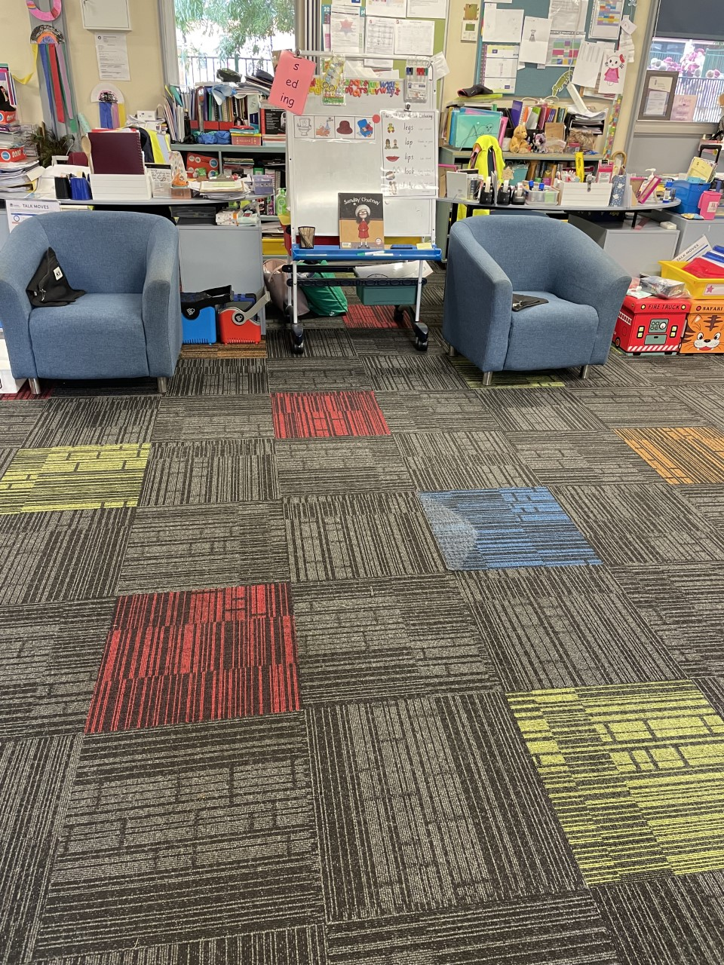
This is where I will sit for group time. We will listen and learn on the mat.

Slide 9
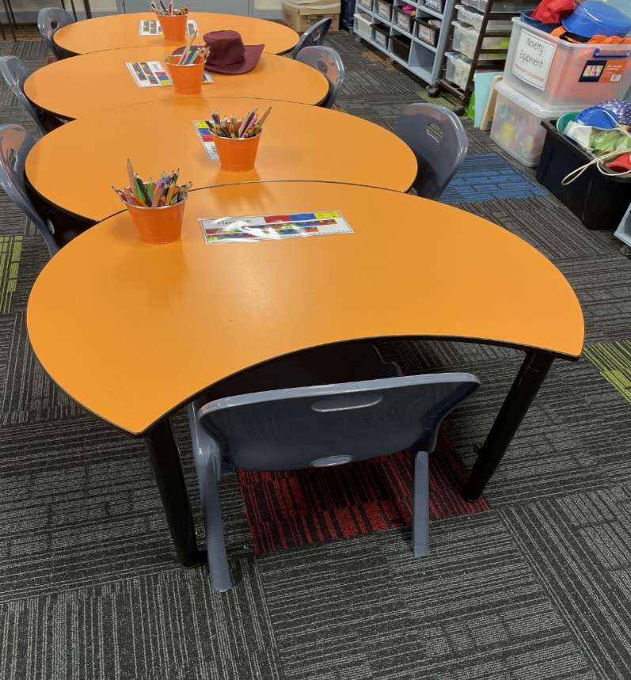
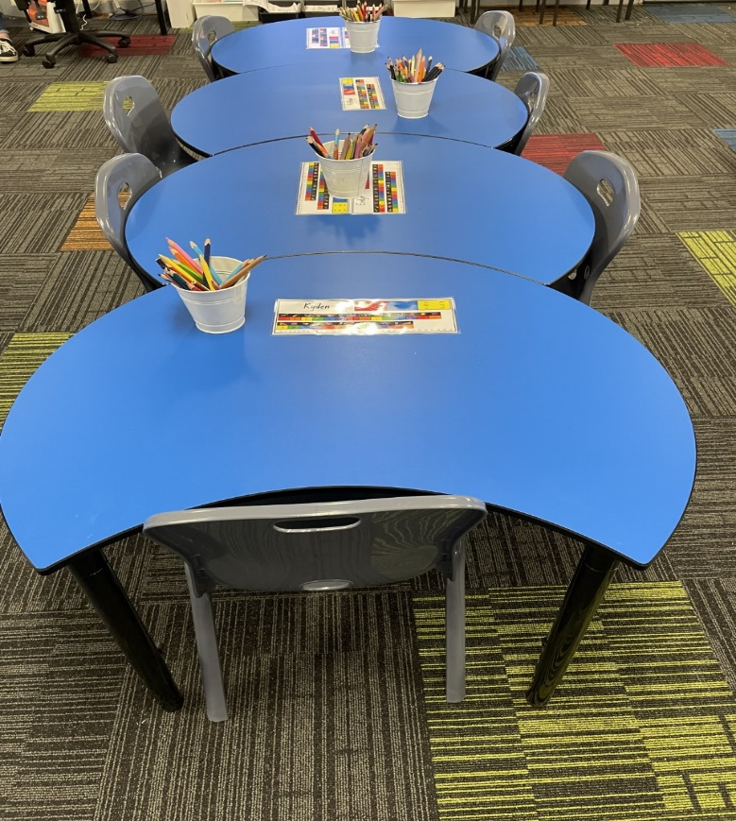
These are the tables where I will do my work.

Slide 10
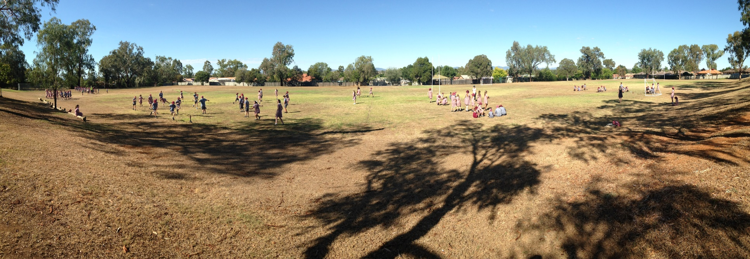
This is the Oval where we do PE.

Slide 11
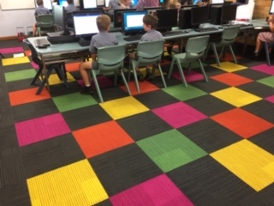
This is the Computer Room. We come here once a week at school.

Slide 12
These are the drink taps. This is where I can go to get a drink of water at recess and lunch time.

Slide 13
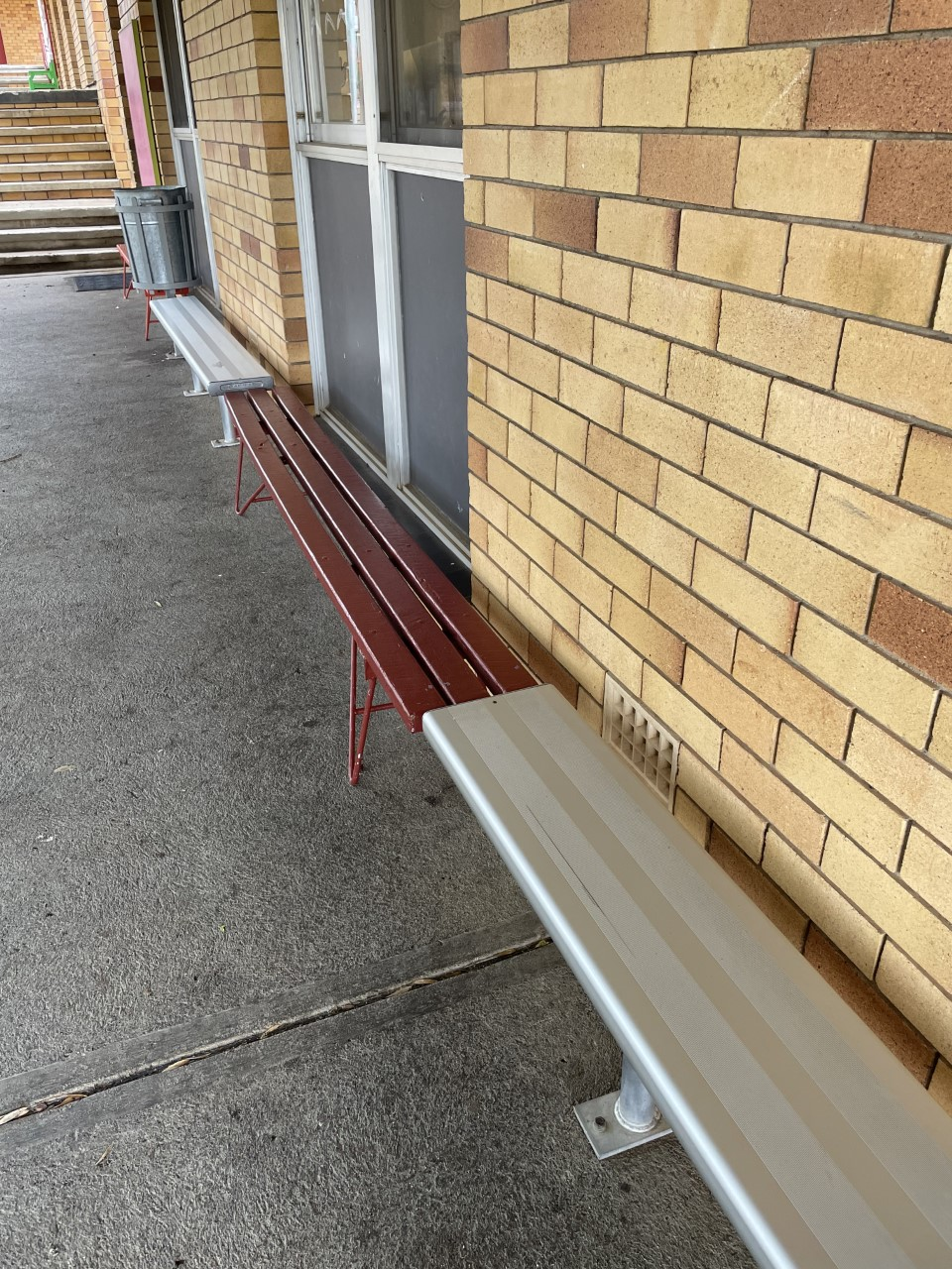
This is where I sit and eat my food at school.

Slide 14
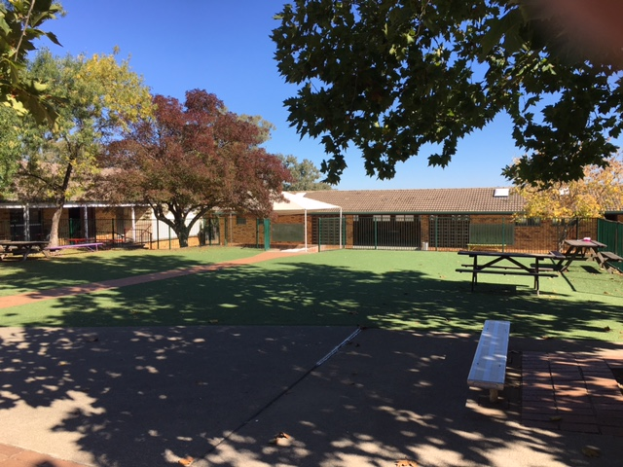
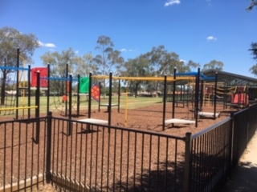
This is the playground that I will play on at school. It is so much fun!

Slide 15
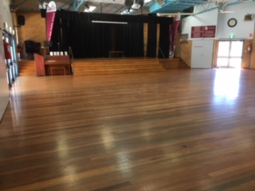
We have special Assemblies in the Hall. This is the Hall. We sometimes do P.E in the Hall.

Slide 16
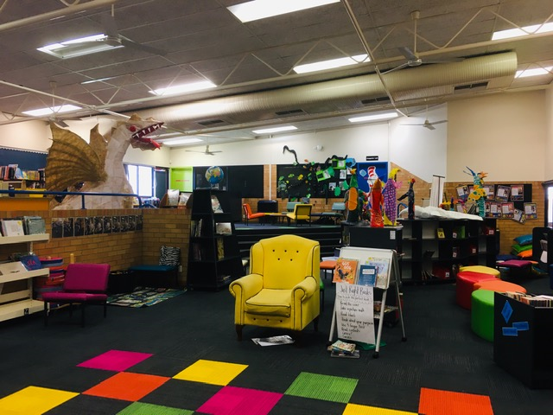
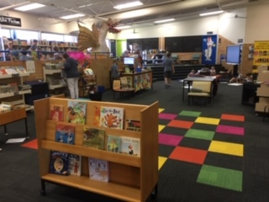
This is the Library. It is a quiet place. We get to borrow books to take home. We need to bring them back to school so we can take new ones home.

Slide 17
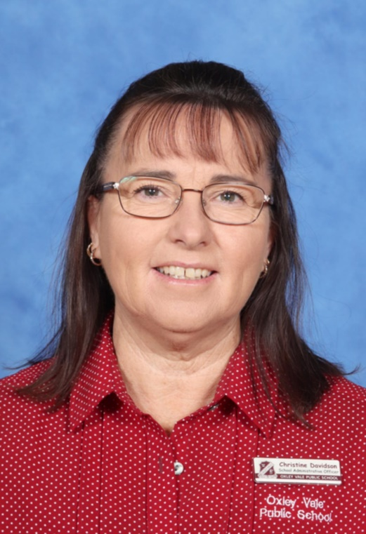
This is Mrs Davidson. She works in the office. If I am hurt or if I am sick I will go to the office to see her.

Slide 19
School is so much fun! We cannot wait to have you at Oxley Vale Public School.

